Slide 1

CAPSTONE PROJECT INTERIM PRESENTATION

Slide 2


INTEREST RATE PREDICTION
MENTOR :
Prof. Vidhya. K
Submitted By :
Lalit Kacha
Tejas Mohan Ayyar
Raj Panchal
Vaidehi Tare
Ruchika Gajeshwar

Slide 3



Problem Statements
Classifying customers into different Loan Interest categories based on their profiles.
To arrive at the segmentation of customers concerning their past data of loans on different parameters. This segmentation will then be used to map different interest rate slabs (1 / 2 / 3) to these customers.
Target
Interest Rate Predictions for different customers.
Technology used
Supervised Learning - Classification
Unsupervised Learning - Clustering

Slide 4

Our Process
Our Process
1
2
3
4
EDA
Visualisations
Missing value imputation
outlier treatment
Statistical analysis
Feature selection
Base model - evaluation
Testing various models and evaluating
Hyper Parameter Tuning of the best Model

Slide 5

Dataset Information
This dataset was provided by Kaggle for a Finance sector problem. The dataset had 164309 Rows and 14 columns in csv format. The data comprises of different features pertaining to various factors of every customer applying for loan.
Variables
Loan_ID
Loan_Amount_Requested
Length_Employed
Home_Owner
Annual_Income
Income_Verified
Purpose_Of_Loan
Debt_To_Income
Inquiries_Last_6Mo
Months_Since_Deliquency
Number_Open_Accounts
Total_Accounts
Gender
Interest_Rate
Numerical
Loan_Amount_Requested
Length_Employed
Annual_Income
Debt_To_Income
Inquiries_Last_6Mo
Months_Since_Deliquency
Number_Open_Accounts
Total_Accounts
Total 8 Features
Missing Values
Length_Employed | 4.48%
Home_Owner | 15.42%
Annual_Income | 15.27%
Months_Since_Deliquency | 53.78%
Categorical
Home_Owner
Income_Verified
Purpose_Of_Loan
Gender
Interest_Rate
Total 5 Features

Slide 6

Data Cleaning
Feature Selection
Loan_ID : Removed as all values were unique.
Loan_Amount_Requested : Converted into numeric as was in string because of “,” in between.
Length_Employed :Converted into numeric from strings.
Recursive Feature Elimination: RFE is a backward elimination technique that would pick the best 'n' features specified by us.
Sequential Feature Selector: SFS, a part of the mlxtend library allows for both forward selection and backward elimination

Slide 7

Missing Values
The Dataset has a total of 8 % missing values.
Length employed imputed with mode since only 4.48% data was missing.
Home owner imputed with mode of Home owner for each employment level to have more variation.
Annual Income was imputed using KNN-Imputer and with numerical features only.
Months since Delinquency Customers who have never missed a debt repayment belong to the null values, hence imputed with max + range = 180+180 = 360 months.

Slide 8

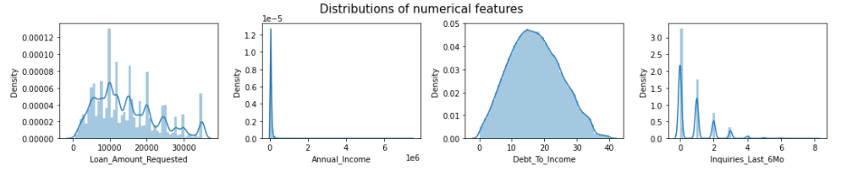
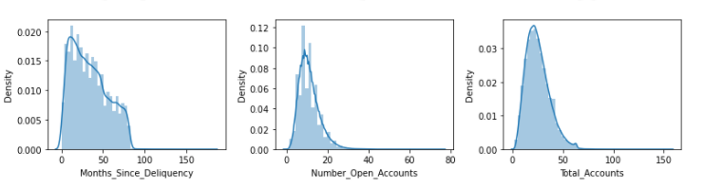
Data Distribution
Most of the features show positive skewness (right skewed). In such cases the mean of the respective columns are greater than their median.

Slide 9

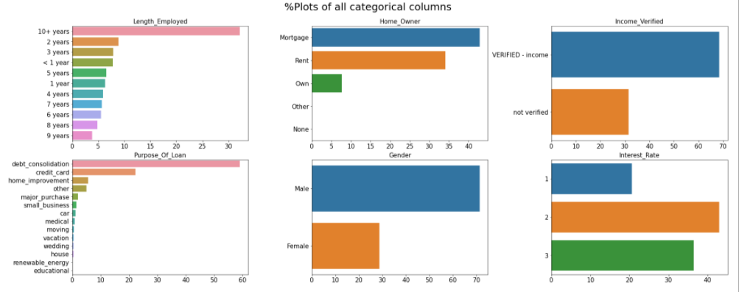
Proportion of Data
The below proportion plot shows us the percentage of occurrence of category within each categorical feature column.

Slide 10

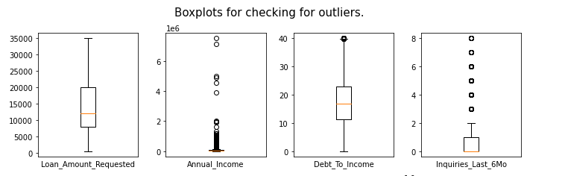
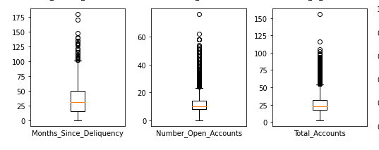
Outliers and Treatment
Except loan_amount_requested all other features have outliers present as can be seen in the boxplot.
Here the outliers have been treated using the IQR method.

Slide 11

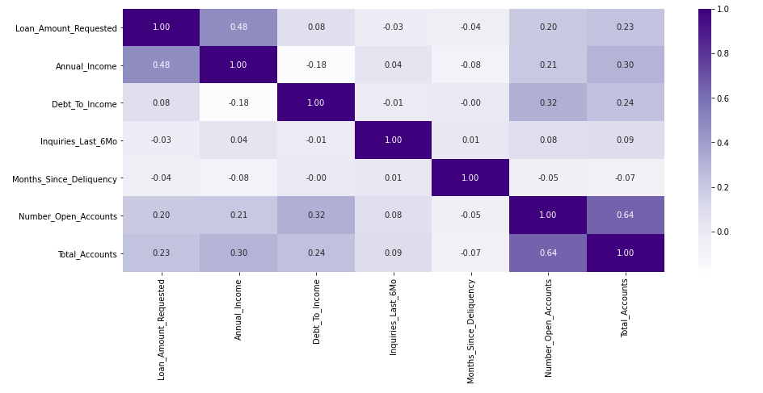
Feature Correlation Heatmap
Annual Income Amount Requested
Total Accounts Open Accounts
Open Accounts Debt to Income
Annual Income Total Accounts

Slide 12

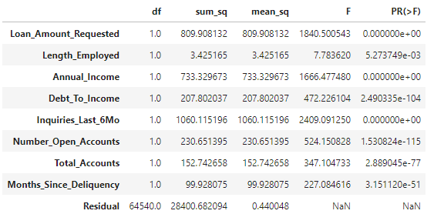
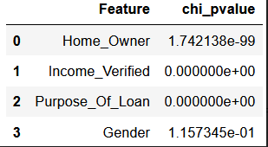
Statistics
Anova Test between Numerical and Target Variable.
H0: There is no difference in means between interest rate groups and a specific feature.
HA: There is a difference in means between interest rate groups and a specific feature.
Interpretation:
All the numerical columns are having differences in mean for each of the target categories.
CHI-Square Test between Categorical and Target Variable.
H0: Assumes that there is no association between the two variables.
HA: Assumes that there is an association between the two variables.
Interpretation:
Gender is the only categorical column that is not seeing any difference within each target category.

Slide 13
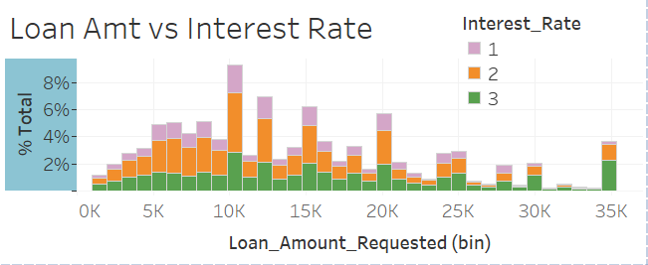
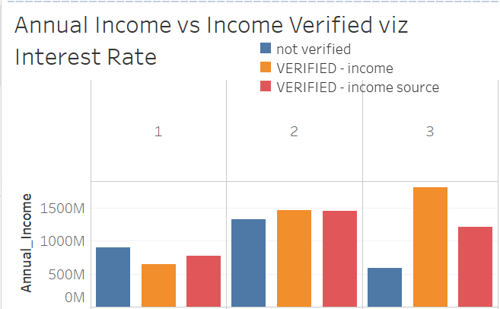
Visualizations vs Interest Rate(A)
Loan Amount vs Interest Rate
Loan Amount distribution is positively skewed. Fewer people tend to ask for higher loan amounts.
We also see that as the amount increases, rate of interest being low or 1 also decreases.
Annual Income vs Income Verified per interest rate
Interest Rate 3 sees maximum applicants with verified income sources.
Interest rate 2 sees the maximum number of not verified income source.

Slide 14
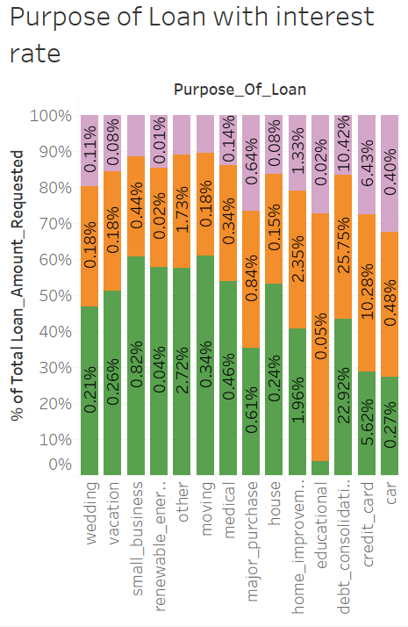
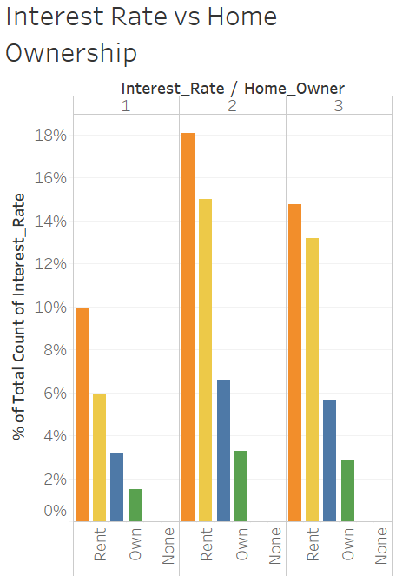
Visualizations vs Interest Rate(B)
Purpose of Loan with Interest Rate
Debt Consolidation tends to get an interest rate of 1 or 2% mostly while payment of credit card bills tend to get a higher interest rate of 2-3%.
Interest Rate vs Home Ownership
Home ownership does not seem to create any impact on the target as is visible in the graph to the right.

Slide 15

Base model
Here we will use Logistic Regression algorithm with ‘multinomial’ argument under the multiclass parameter as we have more than two classes in the target.
The report is as follows:
Train Test Split - 80:20
Target Class | precision | recall | f1-score | support
1 | 0.21 | 0.00 | 0.00 | 6735
2 | 0.45 | 0.68 | 0.54 | 14149
3 | 0.48 | 0.45 | 0.47 | 11978
accuracy |  |  | 0.46 | 32862
macro avg | 0.30 | 0.38 | 0.34 | 32862
weighted avg | 0.41 | 0.46 | 0.40 | 32862
Our model gave an overall accuracy of 46%.

Slide 16

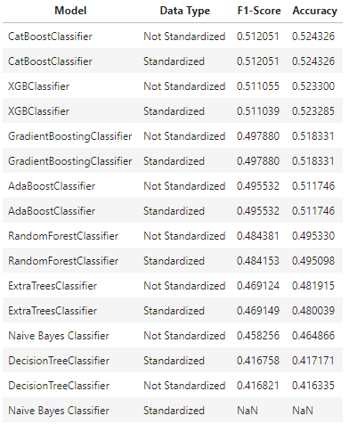
Algorithms used for classification
LogisticRegression
Naïve Bayes Classifier
DecisionTreeClassifier
ExtraTreesClassifier
RandomForestClassifier
AdaBoostClassifier
GradientBoostingClassifier
XGBClassifier
CatBoostClassifier

Slide 17
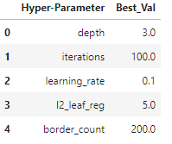

Hyper parameter tuning
3 is best for depth keeping all the other features as default
100 is best for iterations keeping all the other features as default
0.1 is best for learning_rate keeping all the other features as default
5 is best for l2_leaf_reg keeping all the other features as default
200 is best for border_count keeping all the other features as default

Slide 18

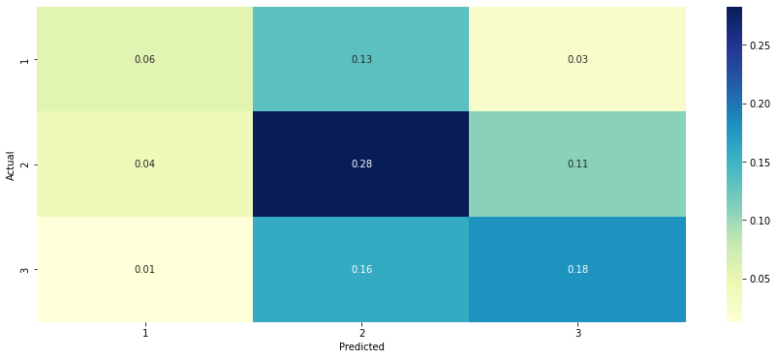
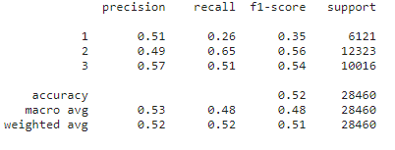
Best Score without SMOTE
Here our Overall Accuracy for the Cat Boost Classifier is 52%

Slide 19
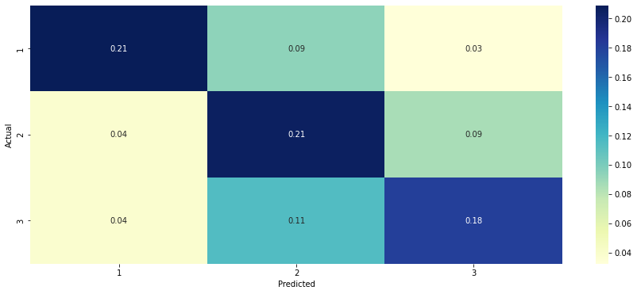
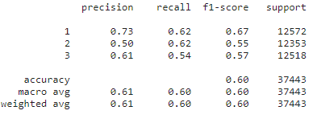
Best Score with SMOTE
Here our Overall Accuracy for the Cat Boost Classifier is 60%

Slide 20

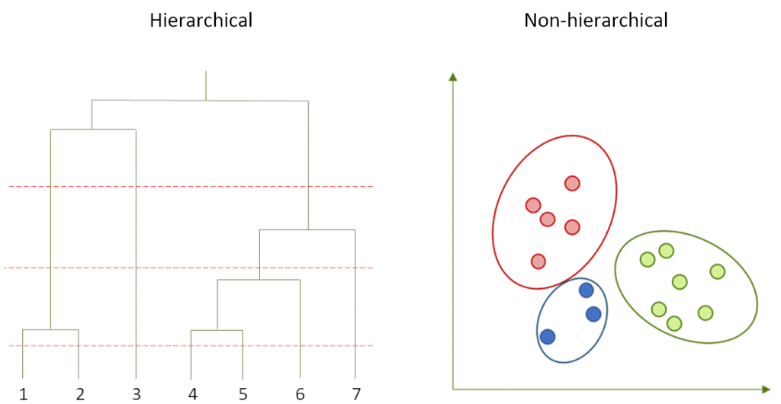
Clustering
Clustering is the task of dividing the population or data points into a number of groups such that data points in the same groups are more similar to other data points in the same group and dissimilar to the data points in other groups.
Hierarchical Clustering
K-Means Clustering
Types of Clustering we Have used:
K-Means Clustering: K-means, using a pre-specified number of clusters, the method assigns records to each cluster to find the mutually exclusive cluster of spherical shape based on distance.
Hierarchical Clustering: Hierarchical methods can be either divisive or agglomerative.

Slide 21

Dimensionality Reduction
It is a common practice to apply PCA (principal component analysis) before a clustering algorithm (such as k-means). ... So if the dataset consists in N points with T features each, PCA aims at compressing the T features whereas clustering aims at compressing the N data-points
After Applying PCA we found that 10 components tends to preserve 95% of variance

Slide 22

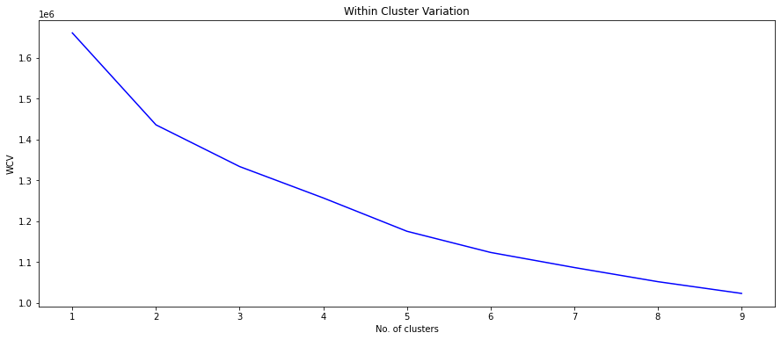
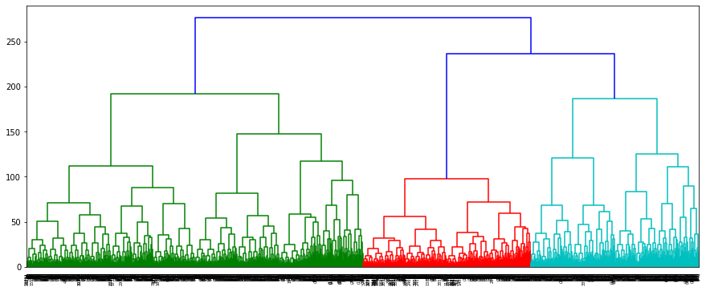
Optimum clusters
WCV is the variation in the data points that are present in the cluster.
WCV gives us Optimal Clusters Values of 2,3 & 4.
We have Selected 3 as the Optimal Number of Clusters.
On taking the sample of 35000 data points we found 3 to be the Optimal Numbers of clusters using the dendrogram method
Finally Both methods(WCV & Dendrogram) gives us 3 as the Optimal numbers of Clusters.

Slide 23
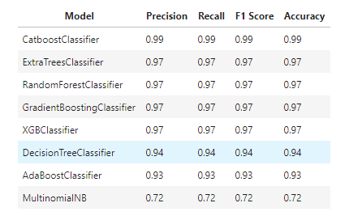
Classification With New Target variable
Suspected Reason behind the low accuracy before
Solution: We observe that 48874 values in our original target match with our new target variable. % of data matching = 34% approx. This is very low for us to be able to create a highly accurate model from our original target set. This could be a reason for the low accuracy we are seeing in our data.

Slide 24





Business application
Classifying the customer base on their past records we can provide them a rate of interest which they deserve and providing them benefits accordingly. This in turn can be used to improve the firm’s reputation and create a strong loyalty base.
Customer Care
Since the global financial crisis, risk management in banks has gained more prominence, and there has been a constant focus around how risks are being detected, measured, reported and managed. With the help of this banks can identify the customers who are good for their business. They can safeguard their interest by appropriate prediction of customers hence reducing the risk
Risk analysis
Through the depiction of the customer segmentation through machine learning, Marketing team can apply various analysis over it and therefore they can plan there marketing scheme on that basis. For example:- If they observe there category 2 customers are more so then there marketing will be centric to them more compared to that of others.
Marketing strategy
In this project we can dividing our customers by assigning them different interest rates. This segmentation customers in 3 clusters will help in focusing on each cluster individually by means of creating policies, schemes and offers according to each specific cluster and in turn we can encourage or discourage shifting of customers from one segment to another.
Customer Segmentation

Slide 25

Conclusion
For Classification:
After applying SMOTE on the dataset we see an improvement in our cat boost classifier report with an 8% increase in accuracy. We feel that this is the best score that can be obtained using the original target variable.
For Clustering:
After clustering and creating ML models on the new target, we can clearly see a massive improvement in model performance. It seems like there must have been some more parameters that have determined our original target variable that was not provided to us within our dataset.

Slide 26

Thank you

